Slide 1
Unit 2: The Internet
Table of Contents
Lesson 1: Welcome to the Internet
Lesson 2: Building a Network
Lesson 3: The Need for Addressing
Lesson 4: Routing & Redundancy
Lesson 5: Packets
Lesson 6: HTTP and DNS
Lesson 7: Internet Dilemmas, Pt 1
Lesson 8: Internet Dilemmas, Pt 2
Lesson 9: Assessment Day

Slide 2
Unit 2 - Lesson 1
Welcome to the Internet

Slide 4
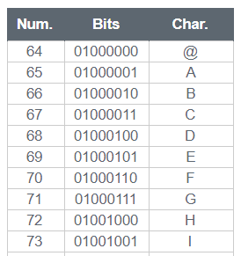
Unit 2 Lesson 1 - Warm Up
Prompt:
We’ve learned to represent images, text, and sound digitally - but we haven’t discussed what we do with all this digital data. How do you see people sharing this kind of data in the real world? Who do they want to share it with and why?

Slide 6
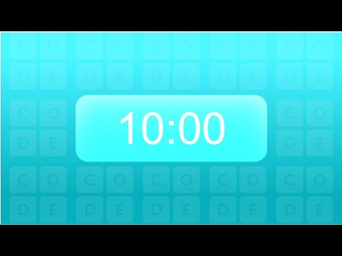
Unit 2 Lesson 1 - Activity
Prompt: Answer each of these questions your journal.
What is the Internet?
What questions do you have about how the Internet works?
AP CSP
Journal

Slide 7
Unit 2 Lesson 1 - Activity
Do This: Choose one answer to each of these questions from your journal and write it on a sticky note.
What is the Internet?
What questions do you have about how the Internet works?
AP CSP
Journal
1
2

Slide 8
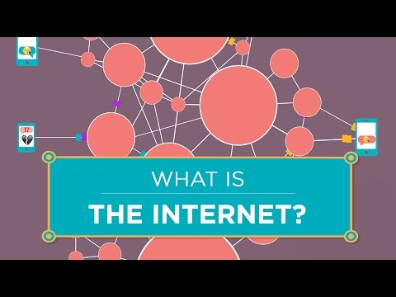
Unit 2 Lesson 1 - Activity
NOTE:
Stop at 1:30

Slide 9
Unit 2 Lesson 1 - Activity
Do This: Join your partner in the Internet Simulator on Level 1
Partner #1 -
(Dani)
Partner #2 -
(Hannah)

Slide 10
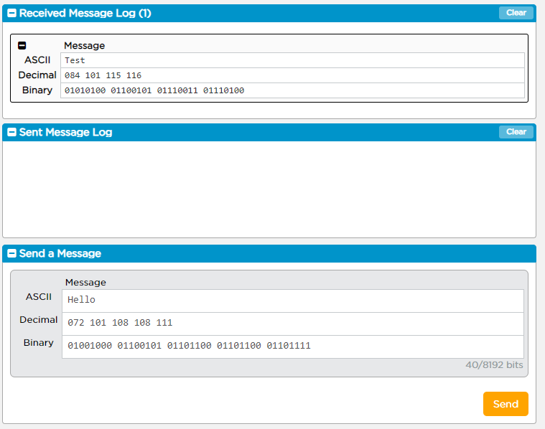
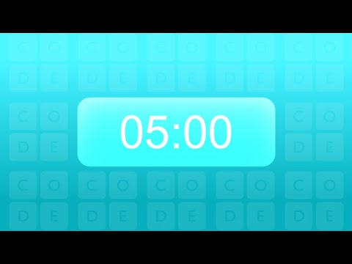
Unit 2 Lesson 1 - Activity
Do This:
Explore the Internet Simulator. How does it work? What can I do with it?

Slide 11
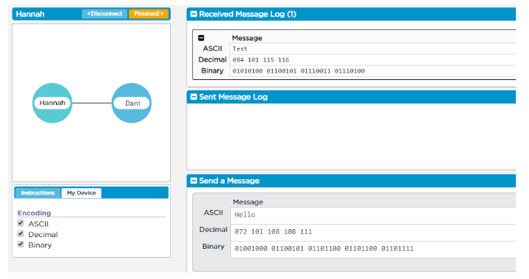
Unit 2 Lesson 1 - Activity
Teacher Demo

Slide 12
Unit 2 Lesson 1 - Activity
Prompt:
How is the Internet Simulator similar to the Internet?
How is it different?

Slide 14
Unit 2 Lesson 1 - Wrap Up
NOTE:
Start at 1:30
Notes:
This slide contains a video for ‘What is the Internet’ from Code.org’s Youtube channel

Slide 15
Unit 2 - Lesson 2
Building a Network

Slide 17
Unit 2 Lesson 2 - Warm Up
Prompt:
In the previous lesson, we explored the Internet Simulator, where each of you were connected to one other person by a single wire. What are the potential problems with this setup?

Slide 19
Unit 2 Lesson 2 - Activity
Human Network
You and your group should have:
string

Slide 20
Unit 2 Lesson 2 - Activity
Rules for all Challenges:
Only two people can be connected by a single string.
You can be connected to multiple people at the same time via multiple strings.

Slide 21
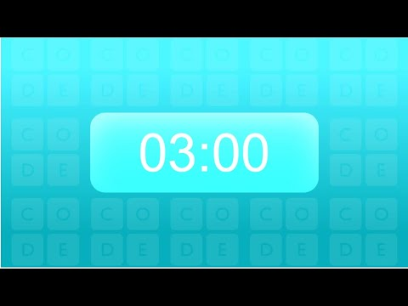
Unit 2 Lesson 2 - Activity
Challenge #1: As a group, create a network where everyone can speak directly to everyone else.

Slide 22
Unit 2 Lesson 2 - Activity
Guideline A: Strings cost money, so try to use the least number of strings possible
Challenge #2: As a group, create a network that uses the least number of strings.

Slide 23
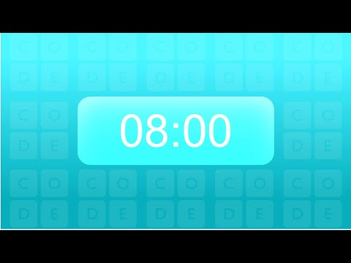
Unit 2 Lesson 2 - Activity
Guideline A: Strings cost money, so try to use the least number of strings possible
Guideline B: Strings can be cut, which might disconnect people from the network
Challenge #3: As a group, create a network that keeps everyone connected even if one of the lines is cut

Slide 24
Unit 2 Lesson 2 - Activity
Guideline A: Strings cost money, so try to use the least number of strings possible
Guideline B: Strings can be cut, which might disconnect people from the network
Guideline C: Direct Connections are faster than long paths with indirect connections
Challenge #4: As a group, create a network that you feel balances all 3 guidelines.

Slide 25
Unit 2 Lesson 2 - Activity
Prompt:
Thinking about our 3 guidelines, what is a strength of the network your group created?
What is a weakness for the network your group created?

Slide 27
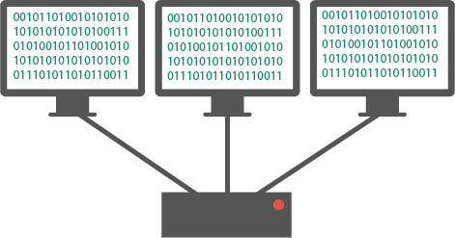
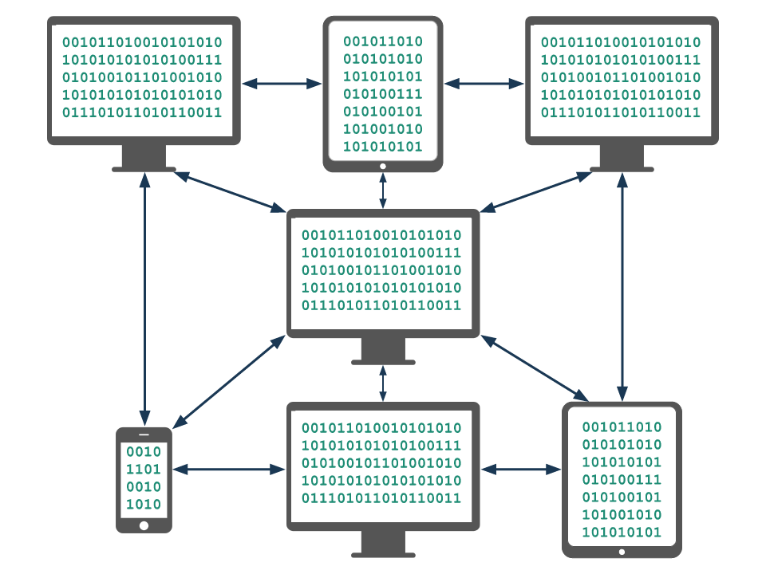
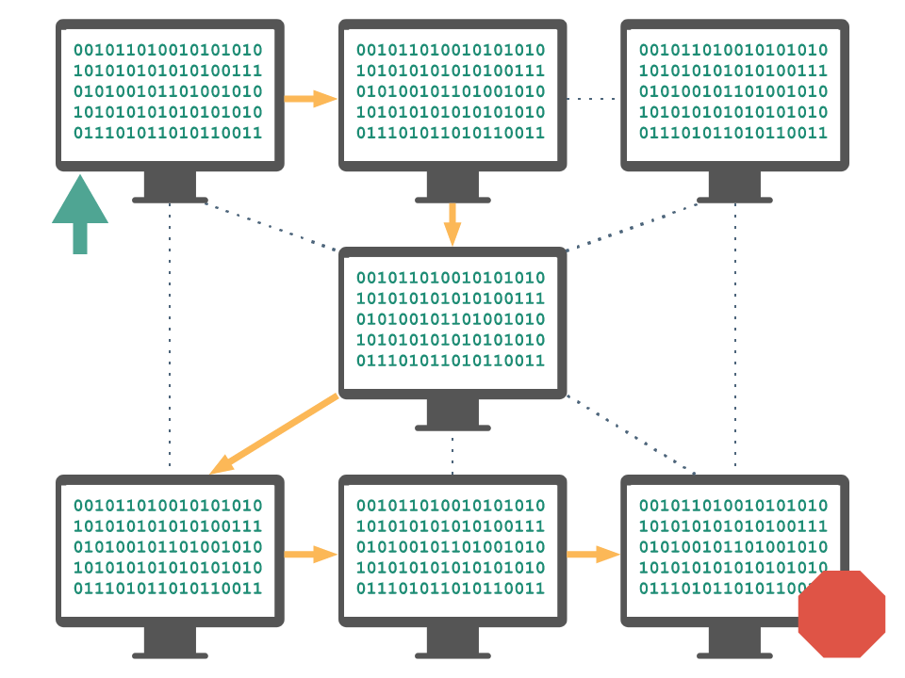
Unit 2 Lesson 2 - Wrap Up
Computing Device: a machine that can run a program, including computers, tablets, servers, routers, and smart sensors
Computing System: a group of computing devices and programs working together for a common purpose
Computing Network: a group of interconnected computing devices capable of sending or receiving data.
Path: the series of connections between computing devices on a network starting with a sender and ending with a receiver.
Bandwidth: the maximum amount of data that can be sent in a fixed amount of time, usually measured in bits per second.

Slide 28
Unit 2 Lesson 2 - Wrap Up
Prompt: How would you use these words to describe today’s activity?
Computing Device
Computing System
Computing Network
Path
Bandwidth

Slide 29
Unit 2 Lesson 2 - Wrap Up
Computing Device: a machine that can run a program, including computers, tablets, servers, routers, and smart sensors
Computing System: a group of computing devices and programs working together for a common purpose
Computing Network: a group of interconnected computing devices capable of sending or receiving data.
Path: the series of connections between computing devices on a network starting with a sender and ending with a receiver.
Bandwidth: the maximum amount of data that can be sent in a fixed amount of time, usually measured in bits per second.

Slide 30
Unit 2 - Lesson 3
The Need for Addressing

Slide 32
Unit 2 Lesson 3 - Warm Up
Prompt:
Imagine you were in a room with 5 other people, all with the same name as you.
What might happen when you start communicating?

Slide 34
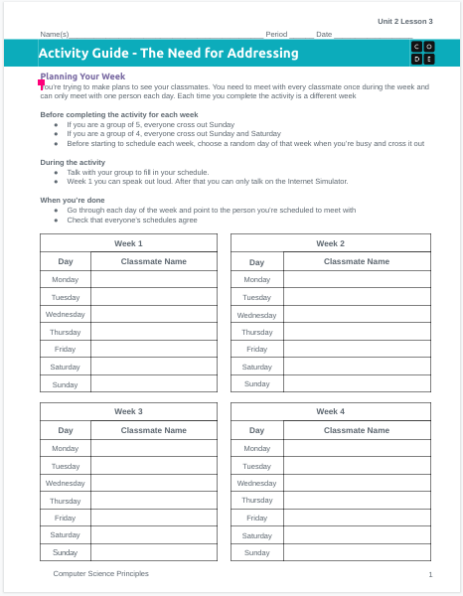
Unit 2 Lesson 3 - Activity
The Need for Addressing
You should have:
Activity Guide
Pen or pencil

Slide 35
Unit 2 Lesson 3 - Activity
Do This: With your group follow the directions given in the box for Week 1
If you are a group of 5, everyone cross out Sunday
If you are a group of 4, everyone cross out Sunday and Saturday
Before starting to schedule each week, choose a random day of that week when you’re busy and cross it out
Once your group is ready, fill in your schedules.
Week 1
Day | Classmate Name
Monday
Tuesday | XXXX BUSY XXXX
Wednesday
Thursday
Friday
Saturday | XXXXXXXXXXX
Sunday | XXXXXXXXXXX

Slide 36
Unit 2 Lesson 3 - Activity
Prompt: With your group check that everyone's schedules match. Then discuss what worked well, what made this tricky, if there's anything you want to try differently in Week 2.

Slide 37
Unit 2 Lesson 3 - Activity
Do This: With your group follow the same directions to set up Week 2
If you are a group of 5, everyone cross out Sunday
If you are a group of 4, everyone cross out Sunday and Saturday
Cross out a new random day
Week 2
Day | Classmate Name
Monday
Tuesday
Wednesday
Thursday | XXXX BUSY XXXX
Friday
Saturday | XXXXXXXXXXX
Sunday | XXXXXXXXXXX

Slide 38
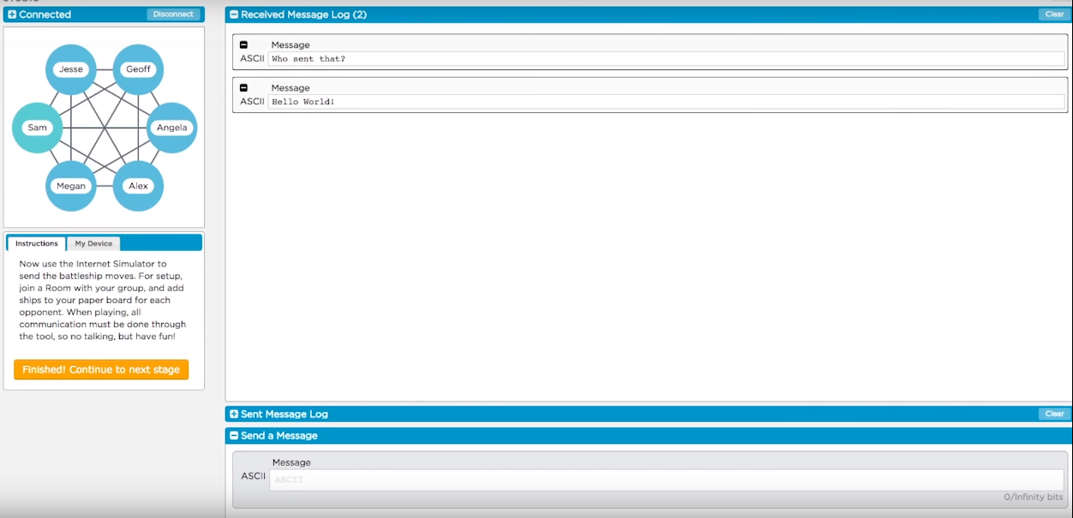
Unit 2 Lesson 3 - Activity
Complete Week 2!
Do This:
Go to Lesson 3 - Level 1
Join a room with your group mates.
Once everyone is in the room complete Week 2 on the simulator.
No talking!

Slide 39
Unit 2 Lesson 3 - Activity
Prompt: Fill out the top on the back side of your sheet. What problems did you encounter? How do you want to fix them in Week 3?

Slide 40
Unit 2 Lesson 3 - Activity
Complete Week 3!
Do This:
Agree with your group on the set of rules you'd like to try this time around for how to communicate.
Set up your boards for Week 3
Complete Week 3, again no talking!

Slide 41
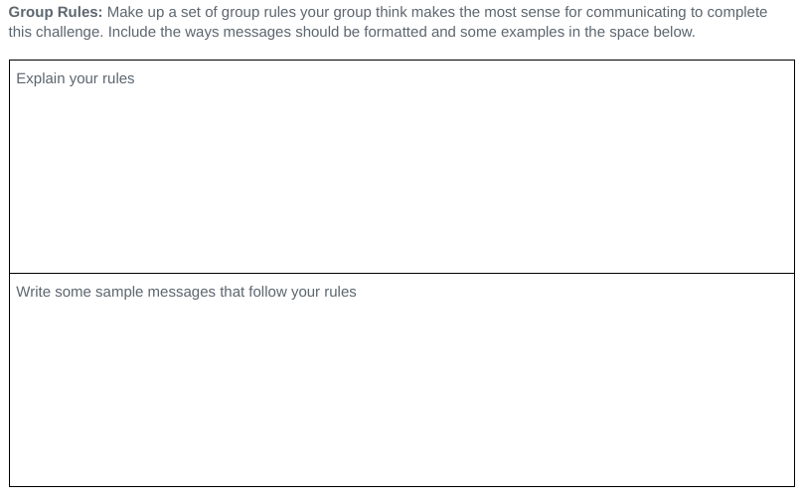
Unit 2 Lesson 3 - Activity
Do This: Based on your experience, take 5 minutes to write down in the rules section the collective rules you and your team would advise using going forward.
Be ready to share!

Slide 43
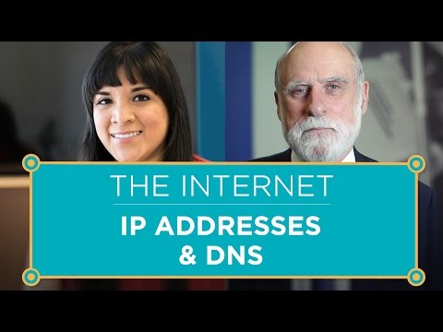
Unit 2 Lesson 3 - Wrap Up

Slide 44
Unit 2 Lesson 3 - Wrap Up
Prompt:
What are the similarities and differences between the Internet Protocol (IP) and the addressing rules our class made? Would rules like our or the IP work if they were secret?

Slide 45
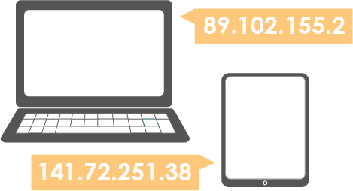
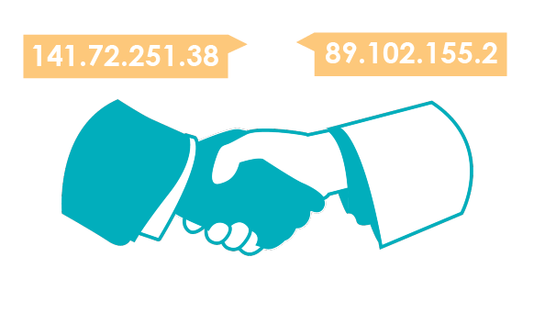
Unit 2 Lesson 3 - Wrap Up
Protocol: An agreed-upon set of rules that specify the behavior of some system
IP Address: The unique number assigned to each device on the Internet.
Internet Protocol (IP): a protocol for sending data across the Internet that assigns unique numbers (IP addresses) to each connected device

Slide 46
Unit 2 - Lesson 4
Routing & Redundancy

Slide 48
Unit 2 Lesson 4 - Warm Up
Prompt:
At the end of class yesterday, we saw that the Internet uses the Internet Protocol and IP Addresses to communicate across the shared Internet. How is this system similar to how we send letters in the mail? How is it different?

Slide 50
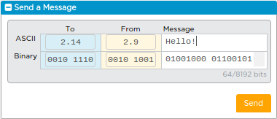
Unit 2 Lesson 4 - Activity
Updated Internet Simulator
Step 1: Open the Internet Simulator
Connect to the same router number as your group
Step 2: Say Hello!
Use the updated version of the Internet Simulator to send a message saying hello to everyone in your group.
Everyone now has an IP Address! This will be important in today’s simulation.

Slide 51
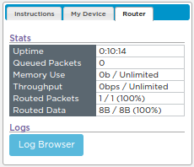
Unit 2 Lesson 4 - Activity
Open the Router Logs
Step 1: Open the Log Browser
Step 2: Look at the Messages

Slide 52
Unit 2 Lesson 4 - Activity
Open the Router Logs
Step 3: View All Messages (including other routers)

Slide 53
Unit 2 Lesson 4 - Activity
Silly Class Survey
Use the Router Logs to choose an IP address from each of the other routers.
Send each person a message asking who they are and choose one of the following questions:
What is your favorite food?
What is your favorite type of animal?
What is your favorite color?
Be sure to also respond to questions you get from people on other routers!

Slide 54
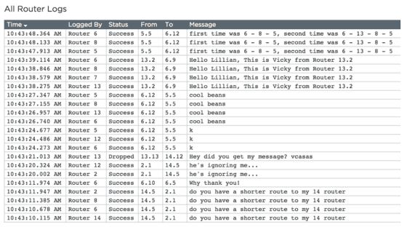
Unit 2 Lesson 4 - Activity
Open the Router Logs
Open the Router Logs Again. You should see a lot more messages now

Slide 55
Unit 2 Lesson 4 - Activity
Prompt:
Can you predict why some messages are appearing multiple times?

Slide 56
Unit 2 Lesson 4 - Activity
Do This:
Pick someone on a different router and send three separate messages with your top three favorite movies or TV shows.
After you send the messages, open the router logs and find these same messages in the logs. Notice how these messages traveled through the network. Did they always take the same path from your router to the other router?
Look at other messages that are being sent. Are there any patterns in the paths that they take?

Slide 57
Unit 2 Lesson 4 - Activity
Prompt: What did you notice about the messages you sent in the router logs?
Did they always take the same path from your router to the other router?

Slide 59
Unit 2 Lesson 4 - Wrap Up
Router: A type of computer that forwards data across a network
Redundancy: the inclusion of extra components so that a system can continue to work even if individual components fail, for example by having more than one path between any two connected devices in a network.
Fault Tolerant: Can continue to function even in the event of individual component failures. This is important because elements of complex systems like a computer network fail at unexpected times, often in groups.

Slide 60
Unit 2 Lesson 4 - Wrap Up
Prompt:
Thinking about these terms (router, redundancy, and fault tolerant), how can we describe what we’ve observed in the router logs at the end of this activity?
What are some practical reasons that you think messages might take different paths from one router to the other?

Slide 61
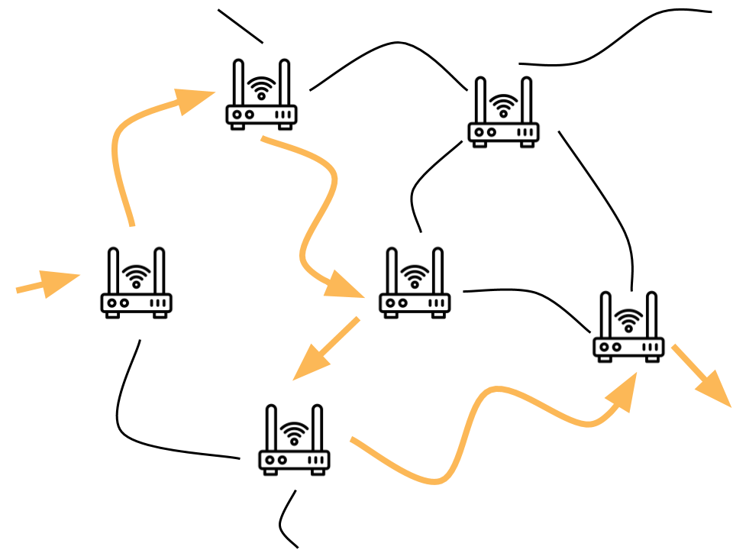
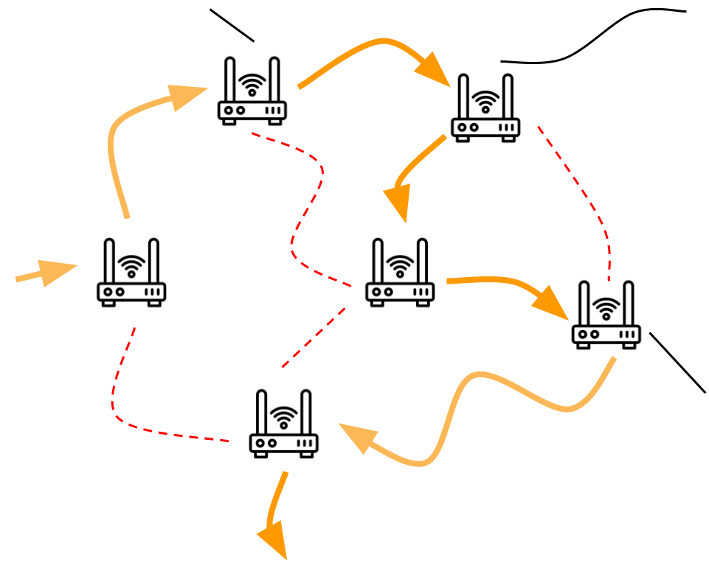
Unit 2 Lesson 4 - Wrap Up
Router: A type of computer that forwards data across a network
Redundancy: the inclusion of extra components so that a system can continue to work even if individual components fail, for example by having more than one path between any two connected devices in a network.
Fault Tolerant: Can continue to function even in the event of individual component failures. This is important because elements of complex systems like a computer network fail at unexpected times, often in groups.

Slide 62
Unit 2 - Lesson 5
Packets

Slide 64
Unit 2 Lesson 5 - Warm Up
Prompt:
Suppose our school library is moving to a new building on campus and the librarian has asked for your help.
What approach would you take if you just needed to clear out the space by the end of the day?
How would your approach change if you had more time and wanted to check that every book made it safely and was on the same shelf it was on before the move?

Slide 65
Unit 2 Lesson 5 - Warm Up
Today we’ll learn about two new protocols, one for when speed is most important, and one when accuracy is most important.

Slide 67
Unit 2 Lesson 5 - Activity
Updated Internet Simulator
Open the Internet Simulator
Join a different router than your partner
Ask your partner for their IP address.
Using only the simulator, have a conversation about one of these topics:
Your favorite movie
Your favorite band/artist
The one superpower you wish you had
Try to discover every way the simulator is different than last time.

Slide 68
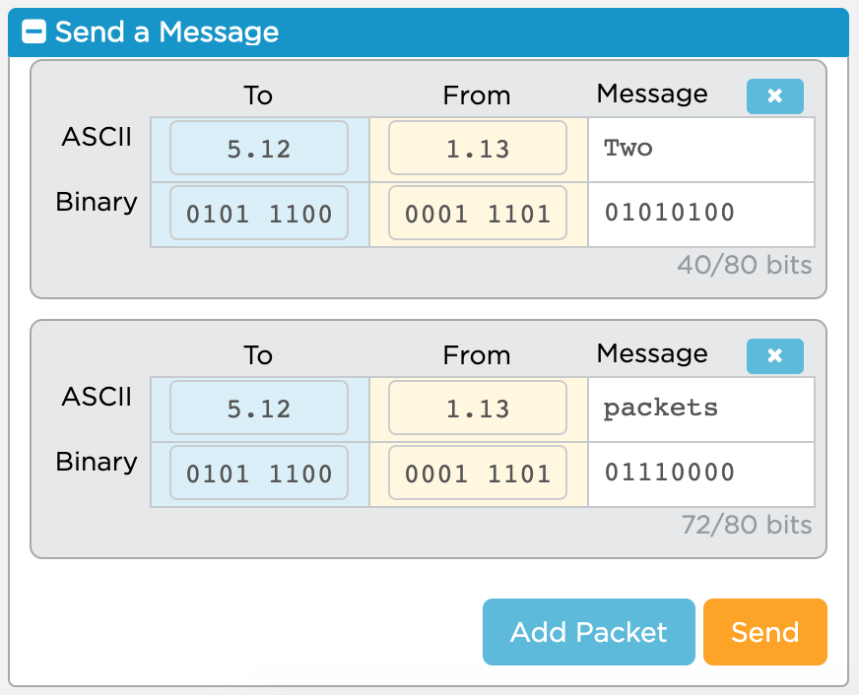
Unit 2 Lesson 5 - Activity
What changed?
A single message can be made up of many “packets” which you can add with the “Add Packet” button
Packets can only be 80 bits long
16 bits are already used for packet metadata, data added to help route the messages
You only have 64 bits, or 8 ASCII characters free for each of your messages

Slide 69
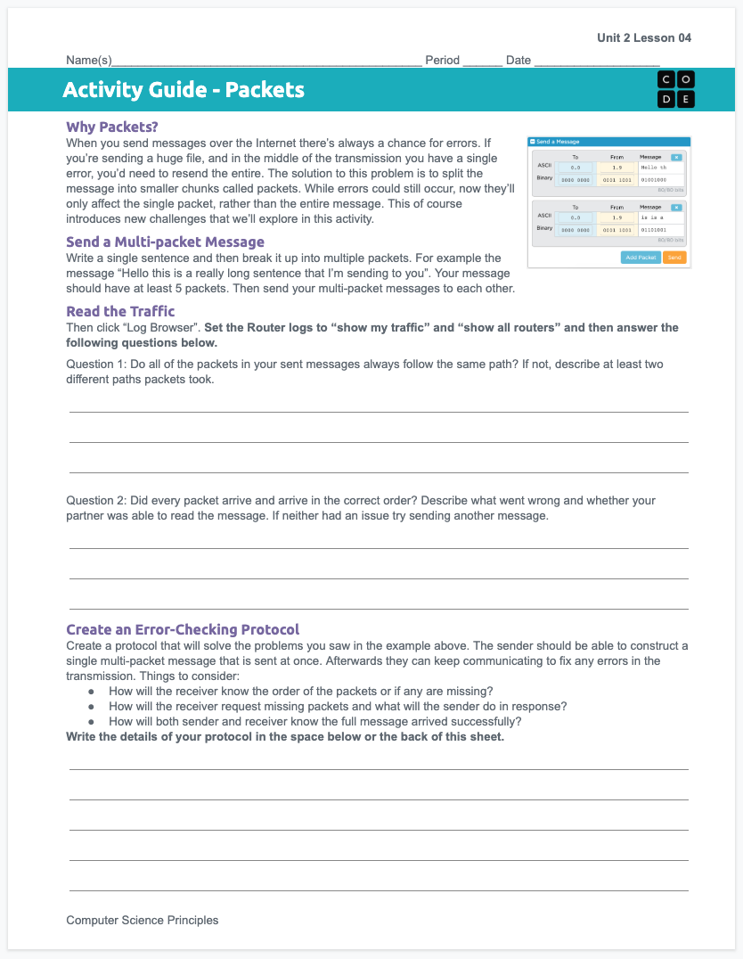
Unit 2 Lesson 5 - Activity
Packets
You should have:
Activity Guide

Slide 70
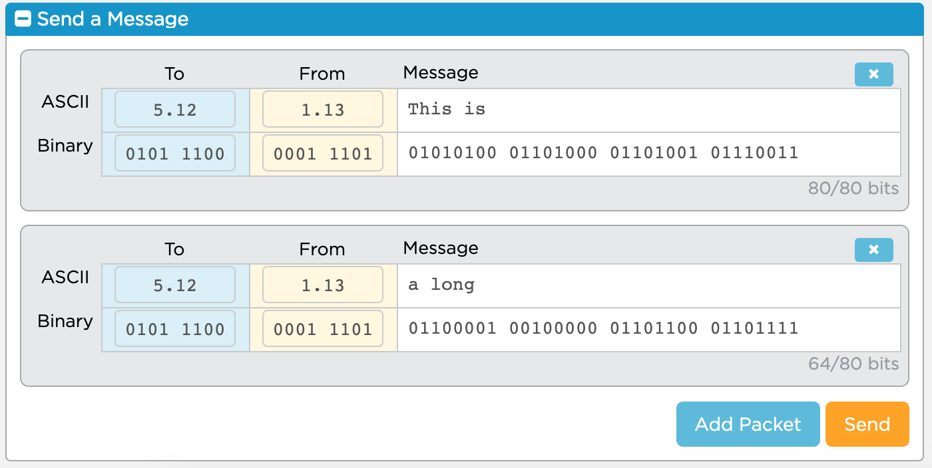
Unit 2 Lesson 5 - Activity
Protocol 1 - Just Send the Packets
Send a single message that includes 5 - 10 packets to your partner.

Slide 71
Unit 2 Lesson 5 - Activity
Read the Traffic
Step 1: Open the Log Browser
Step 2: Filter to your traffic on all routers
Step 3: Read the traffic and answer the questions in your activity guide.

Slide 72
Unit 2 Lesson 5 - Activity
Discuss: Responses to the Activity Guide questions
Packets can take different paths or be dropped, just like messages in the previous lesson
As a result, messages may arrive out of order or incomplete
While a human might be able to understand the original message based on context, a computer would not, the message would simply be lost
This protocol is simple and fast, but not very accurate

Slide 73
Unit 2 Lesson 5 - Activity
There’s two protocols commonly used to send packets online, and depending on the situation websites will choose the one that makes sense.
 | User Datagram Protocol (UDP)
Main Idea
Basics of how it works
Use in real life
Like Protocol 1 or clearing out the library as fast as you can, the goal is to send information quickly without worrying about accuray.
Send all the packets but don’t check if they all get through or arrive in the right order.
Useful when split seconds matter more than correcting errors, like video-conferencing, live streaming, online gaming

Slide 74
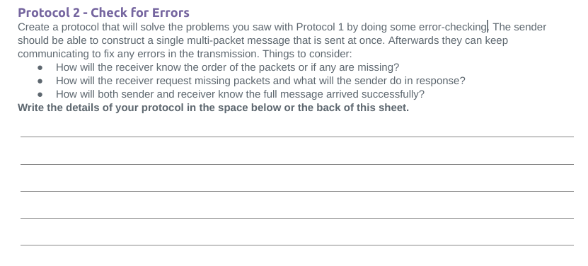
Unit 2 Lesson 5 - Activity
Protocol 2 - Check for Errors

Slide 75
Unit 2 Lesson 5 - Activity
There’s two protocols commonly used to send packets online, and depending on the situation websites will choose the one that makes sense.
 | User Datagram Protocol (UDP) | Transmission Control Protocol (TCP)
Main Idea
Basics of how it works
Use in real life
Like Protocol 1 or clearing out the library as fast as you can. The goal is to send information quickly without worrying about accuray.
Like Protocol 2 or numbering every book in the library. It’s slower but more accurate.
Send all the packets but don’t check if they all get through or arrive in the right order.
Number packets so they can be re-ordered, confirm all were received, resend any missing packets. Multiple back and forth confirmations between sender and receiver.
Useful when split seconds matter more than correcting errors, like video-conferencing, live streaming, online gaming
Useful when accuracy matters more than saving a split second, like sending emails, photos, or just browsing websites

Slide 77
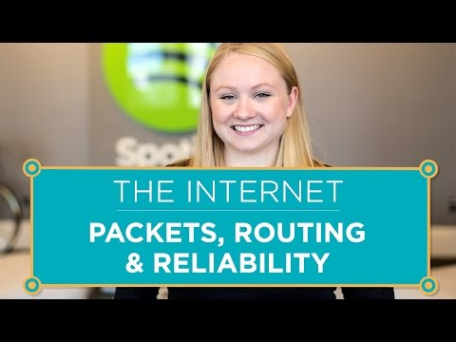
Unit 2 Lesson 5 - Wrap Up

Slide 78
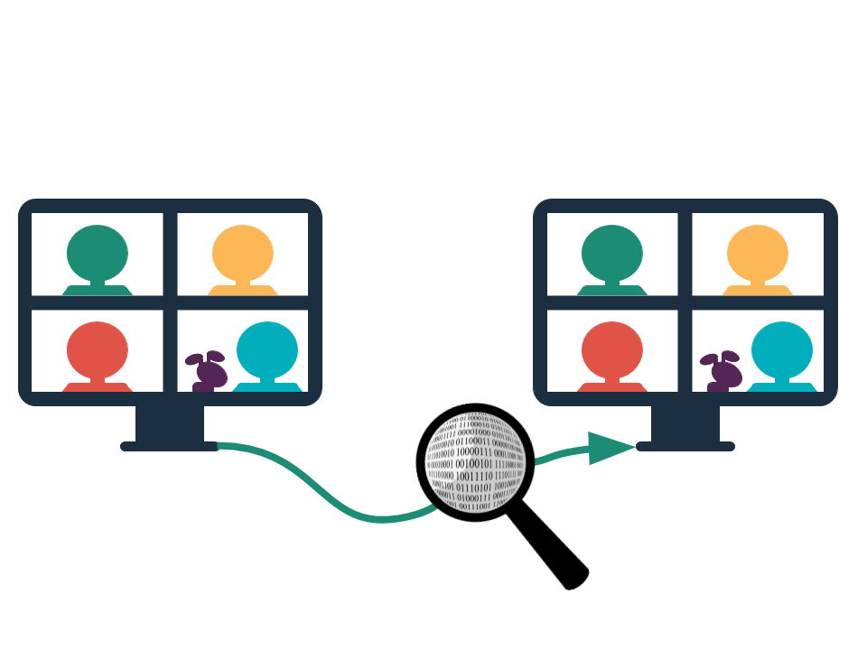
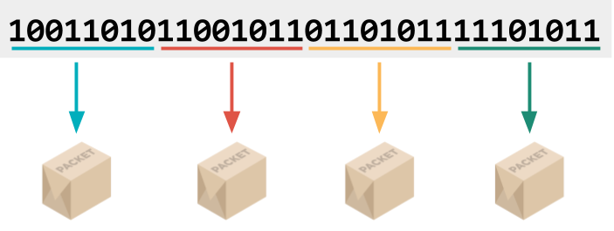
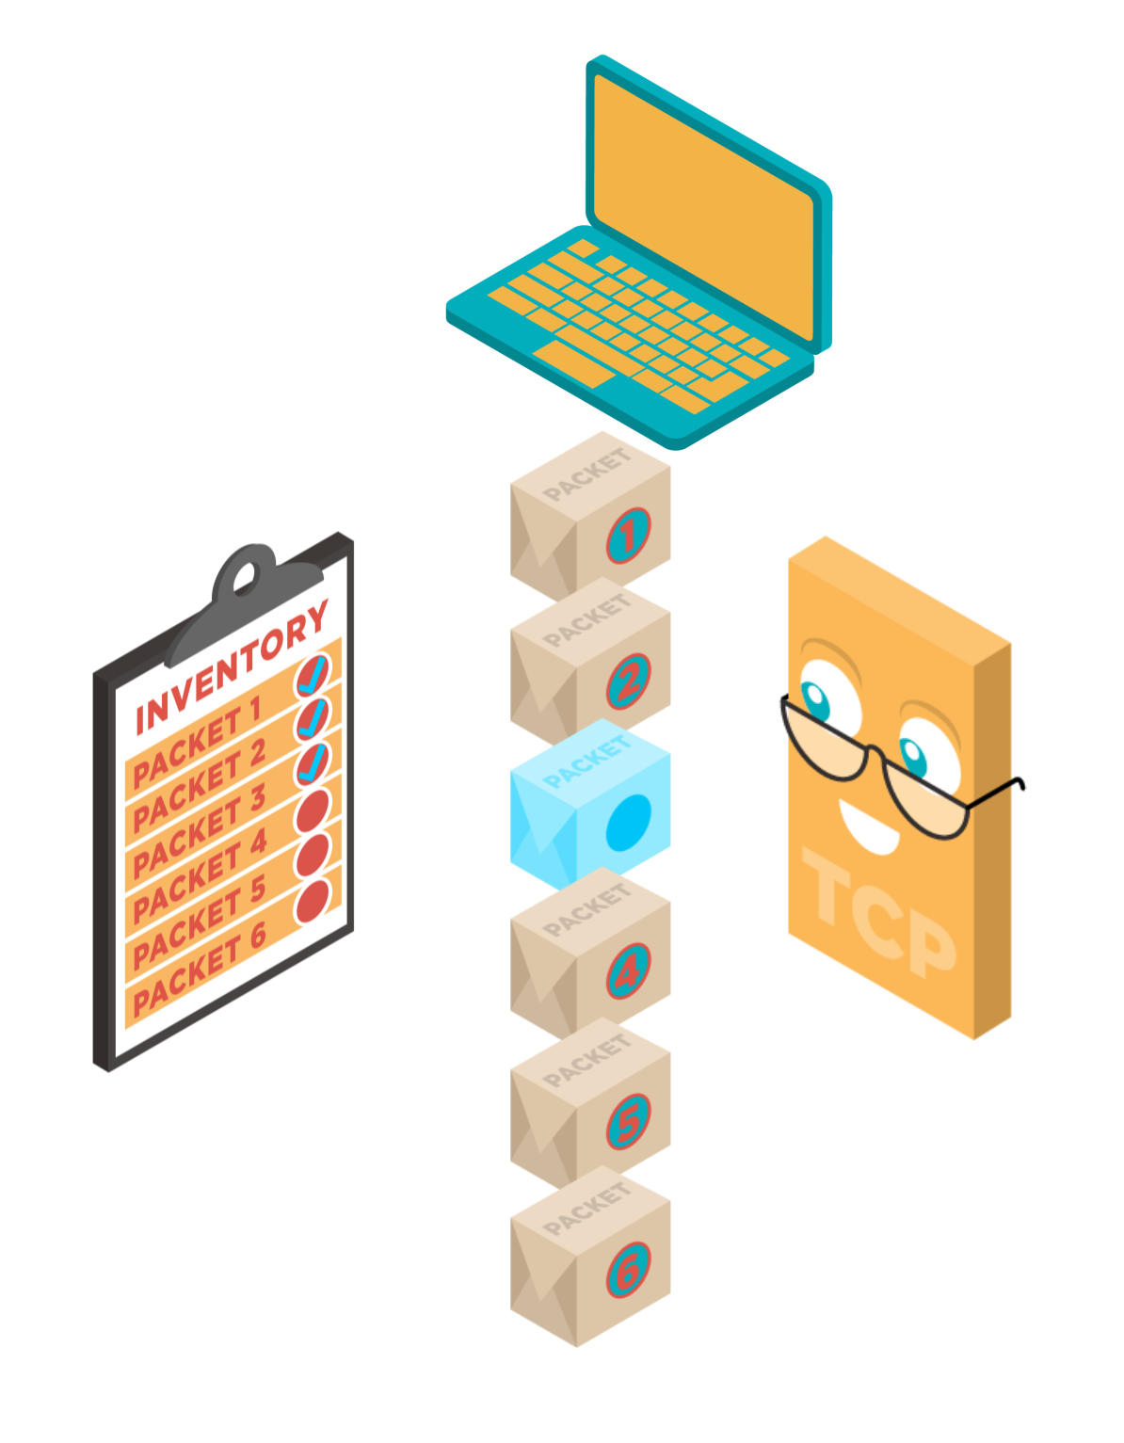
Unit 2 Lesson 5 - Wrap Up
Datastream: Information passed through the internet in packets.
Packet: A chunk of data sent over a network. Larger messages are divided into packets that may arrive at the destination in order, out-of-order, or not at all.
Packet Metadata: Data added to packets to help route them through the network and reassemble the original message.
The IP address of the sender and receiver helps route the message.
Transmission Control Protocol (TCP): A protocol for sending packets that does error-checking to ensure all packets are received and properly ordered
User Datagram Protocol (UDP): A protocol for sending packets quickly with minimal error-checking and no resending of dropped packets
X
X

Slide 79
Unit 2 - Lesson 6
HTTP and DNS

Slide 81
Unit 2 Lesson 6 - Warm Up
Do This: Create a list in your journal of every one of your classmates IP addresses. The only rules:
You may walk around the room
You may share information with classmates
You may talk / share information with only ONE classmate at a time.
Name
IP address

Slide 82
Unit 2 Lesson 6 - Warm Up
Prompt: Discuss with your classmates the following prompts
Why do you think I was switching your classmates’ IP addresses?
If IP addresses can change, is there a better way for everyone to know everyone else’s IP address?

Slide 83
Unit 2 Lesson 6 - Warm Up
If we want the Internet to scale up to billions of devices, then we need a better way to figure out one another’s IP addresses!

Slide 85
Prompt: As we watch the following video take notes in your journal on:
How does the DNS solve the problem of translating domain names like example.com into IP addresses?
How does the DNS help the Internet scale?

Slide 86
Unit 2 Lesson 6 - Activity
AP CSP
Journal
How does the DNS solve the problem of translating domain names like example.com into IP addresses?
How does the DNS help the Internet scale?

Slide 87
Prompt: Discuss the following prompts with a partner:
How does the DNS solve the problem of translating domain names like example.com into IP addresses?
How does the DNS help the Internet scale?

Slide 88
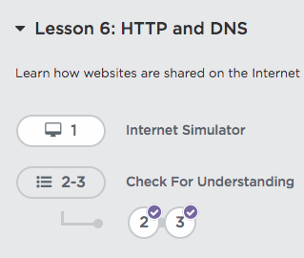
Let’s go use the final version of the Internet Simulator
This time we won’t cheat and ask out loud for one another’s IP addresses!
Do This:
Go to Level 1
on Code Studio

Slide 89
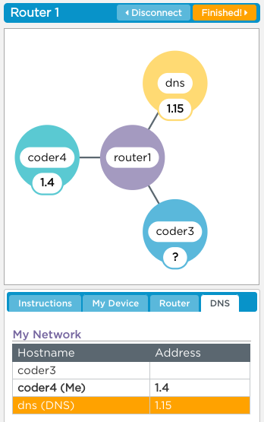
Do This:
Log into this version of the Internet Simulator
No talking at all, not even to get your partner’s IP address
Ask the DNS for the IP address of a user by sending GET username
Use the IP address you get back to communicate with at least 2 friends. You can talk about
In your ideal world what time would school start?
What would you eat for your perfect meal?

Slide 90
Do This: As we watch this video take notes on the HTTP protocol.
What problem is HTTP solving?
What is a GET request and what are your requesting?
How does HTTP rely on the other layers of the Internet?
What problem is HTTP solving?
What do certificate authorities do and why are they necessary?

Slide 91
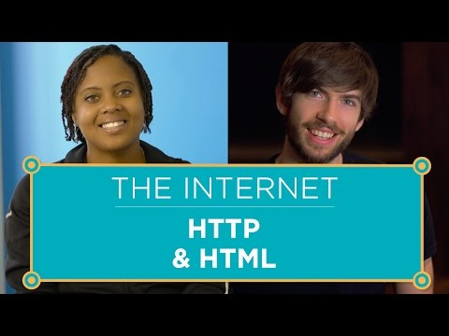
Unit 2 Lesson 5 - Activity
AP CSP
Journal
What problem is HTTP solving?
What is a GET request and what are your requesting?
How does HTTP rely on the other layers of the Internet?
Why are SSL, TLS, and HTTPS necessary?
What do certificate authorities do and why are they necessary?

Slide 92
Prompt: Review these questions with a partner about HTTP
What problem does it solve?
How does it work?
How does it rely on the other layers of the Internet?

Slide 94
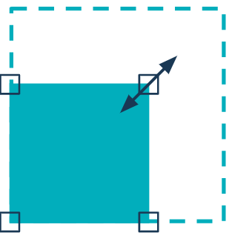
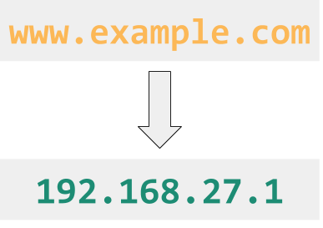
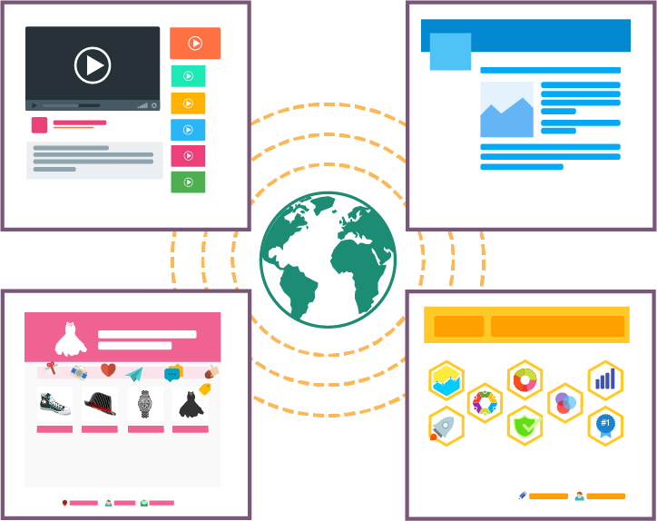
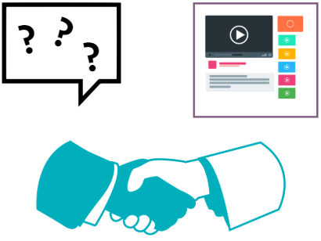
Unit 2 Lesson 6 - Wrap Up
Key Takeaways:
Scalability: the capacity for the system to change in size and scale to meet new demands
The Domain Name System (DNS): the system responsible for translating domain names like example.com into IP addresses
Hypertext Transfer Protocol (HTTP): a protocol for computers to request and share the pages that make up the world wide web on the Internet
World Wide Web: a system of linked pages, programs, and files
The World Wide Web is different from the Internet. The World Wide Web are files, web pages and media. The Internet is the network we use to access those files.
The DNS is an important system in helping the Internet scale.

Slide 95
Unit 2 Lesson 6 - Wrap Up
Prompt:
Using your Layers of the Internet activity guide to help you, explain how each of the different layers is involved when you go to a link like code.org?
code.org

Slide 96
Unit 2 - Lesson 7
Project - Internet Dilemmas Part 1

Slide 98
Unit 2 Lesson 7 - Warm Up
Review
What is the Internet?
Questions about how it works

Slide 100
Unit 2 Lesson 7 - Activity
Chief Technology Advisor

Slide 101
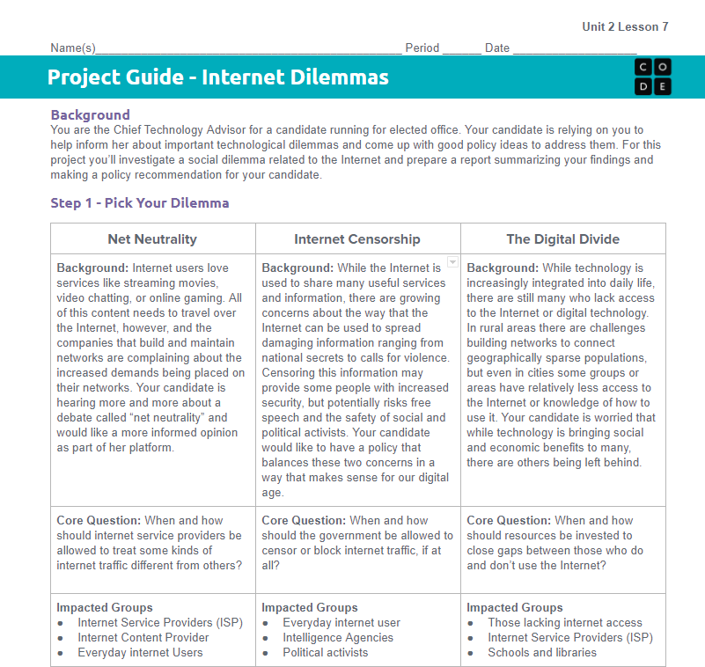
Unit 2 Lesson 7 - Activity
Project Guide:

Slide 102
Unit 2 Lesson 7 - Activity
Options:
Net Neutrality
Internet Censorship
The Digital Divide

Slide 103
Unit 2 Lesson 7 - Activity
Step 1: Choose!
Net Neutrality
Internet Censorship
The Digital Divide

Slide 104
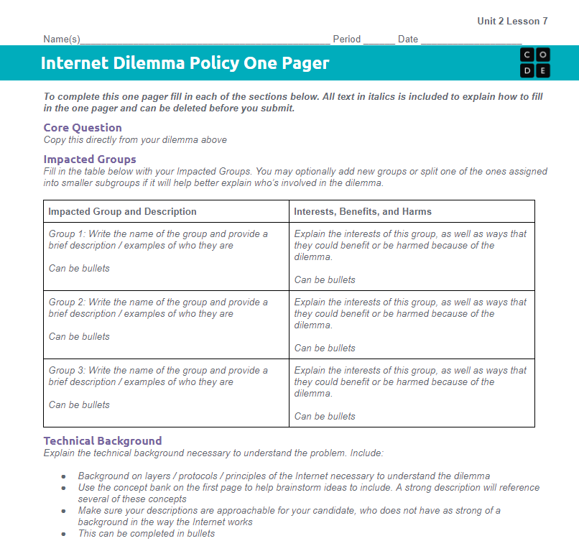
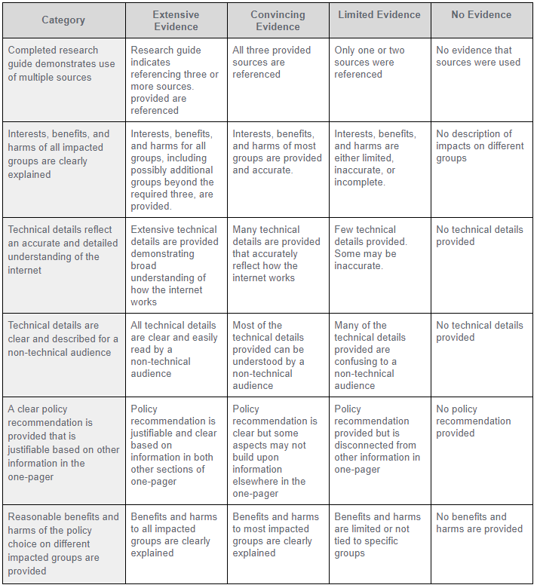
Unit 2 Lesson 7 - Activity
Step 2: Review the One-Pager and Rubric

Slide 105
Unit 2 Lesson 7 - Activity
Step 3: Review the Concept Bank

Slide 106
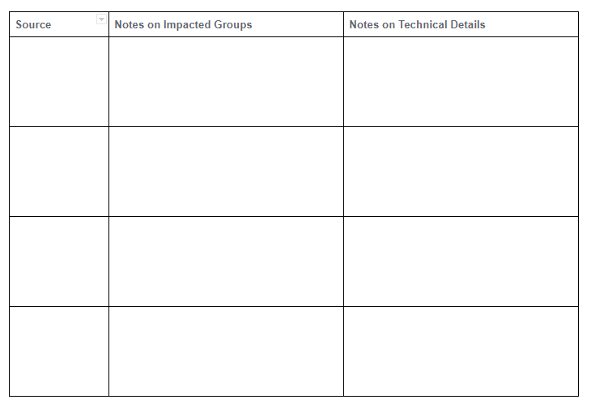
Unit 2 Lesson 7 - Activity
Step 4: Review Your Sources

Slide 108
Unit 2 Lesson 7 - Wrap Up
Digital Divide - differing access to computing devices and the Internet, based on socioeconomic, geographic, or demographic characteristics.
Can affect both individual and groups.
Raises ethical concerns of equity, access, and influence globally and locally.
Affected by the actions of individuals, organizations, and governments.

Slide 109
Unit 2 - Lesson 8
Project - Internet Dilemmas Part 2

Slide 112
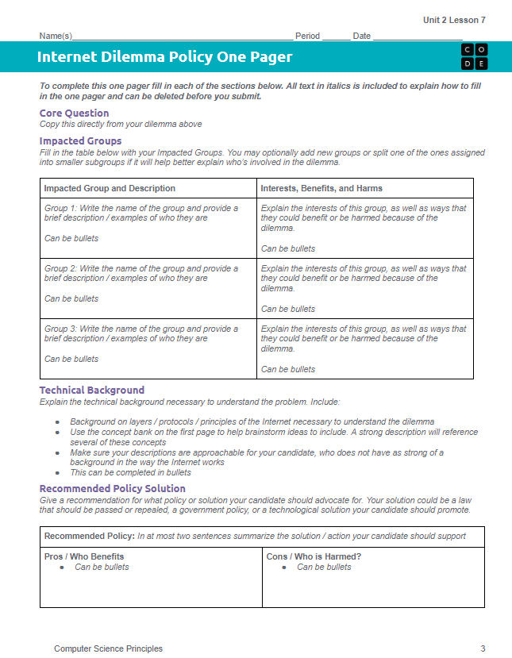
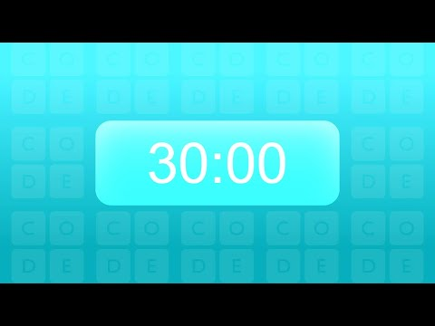
Unit 2 Lesson 7 - Activity
Internet Dilemma Policy One Pager
Don't forget to check the rubric as you work!

Slide 113
Unit 2 Lesson 7 - Activity
Share Out
Net Neutrality

Slide 114
Unit 2 Lesson 7 - Activity
Share Out
Internet Censorship

Slide 115
Unit 2 Lesson 7 - Activity
Share Out
The Digital Divide

Slide 117
Unit 2 Lesson 8 - Wrap Up
Submit
Your Project Guide

Slide 118
Unit 2 - Lesson 9
Assessment Day

Slide 121
Unit 2 Lesson 9 - Activity
Unit Assessment

